Slide 1
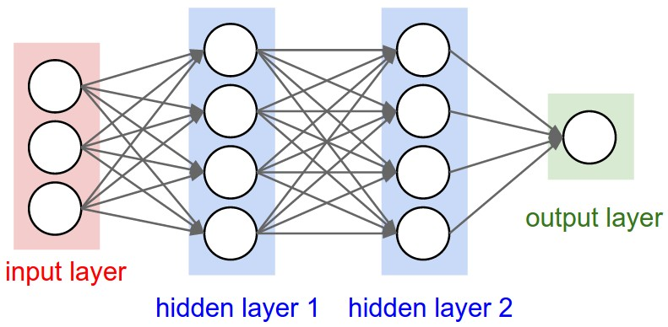
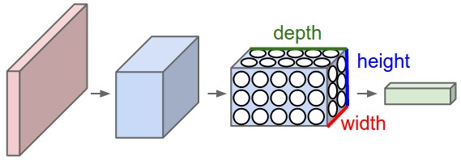
NN vs CNN
Convolutional Layer, Pooling Layer, and Fully-Connected Layer
Break it Identifying pieces Connecting

Slide 2
Multilayer perceptron (MLP)
Very common
Provide very good results (great accuracy)
the training time remains reasonable
Good for small to average datasets
For larger datasets with larger images, the number of parameters for the model increases exponentially, therefore, training becomes longer and performance poorer
MLPs are extremely efficient to solve several categories of problem such as classification, estimation, approximation, recognition, etc

Slide 3
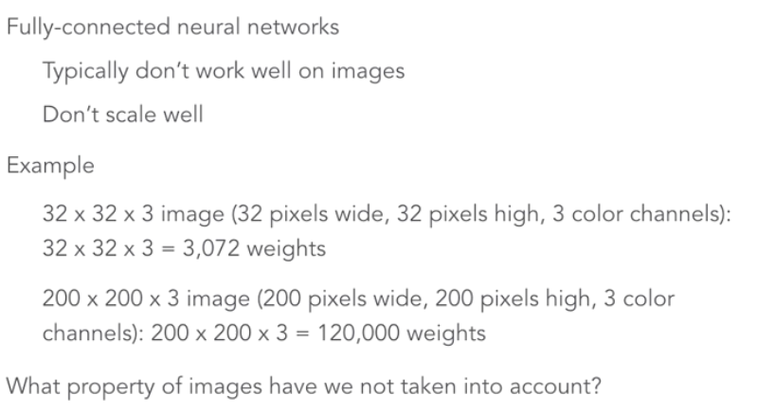
Space between pixels

Slide 4
Create a Deep Learning model to perform a cat or dog classification task
Dataset of images sized 420x420px grayscale
After the training, the model is supposed to classify the image as a dog or cat
Multilayer perceptron
Input layer of 128 neurons
each neuron of the layer receives the 420x420 pixels values as input and assigns a weight per pixel value, which is 420x420 = 176400 weights per neuron
Multiplied by total 128 neurons
add 128 bias (one bias per neuron)
This tiny model will have to learn more than 22 million parameters, for only 128 neurons and a single intermediate layer.

Slide 5
Need for another Network
Training a multilayer perceptron requires to provide input data as a vector (a one-dimension array)
By flattening the image, we lose this information, it becomes more difficult for the network to interpret the data during the training phase
The convolution is a kind of product operation of a filter with a matrix of image to extract from it some pre-determined characteristics.

Slide 6
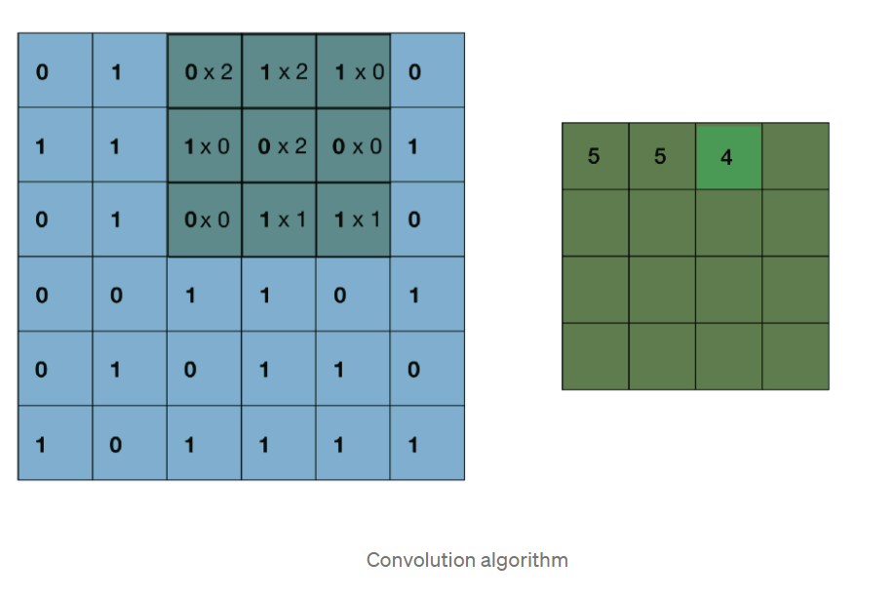

Slide 7
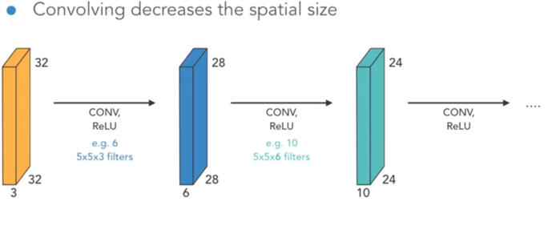

Slide 8
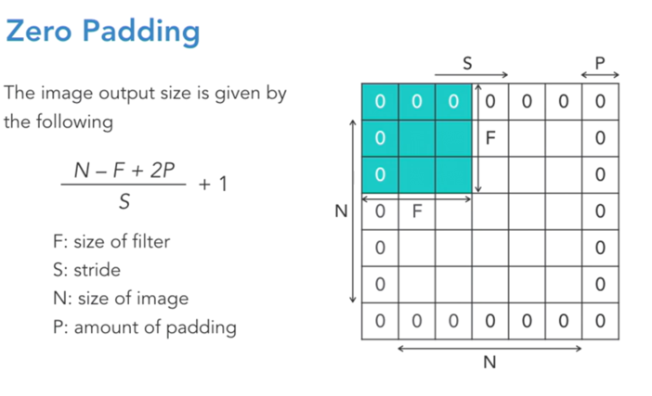

Slide 9
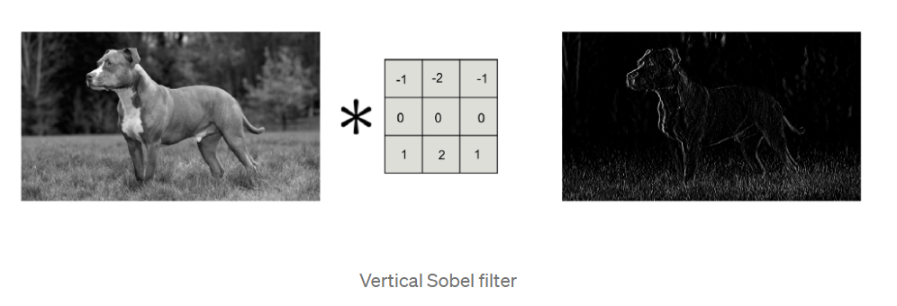
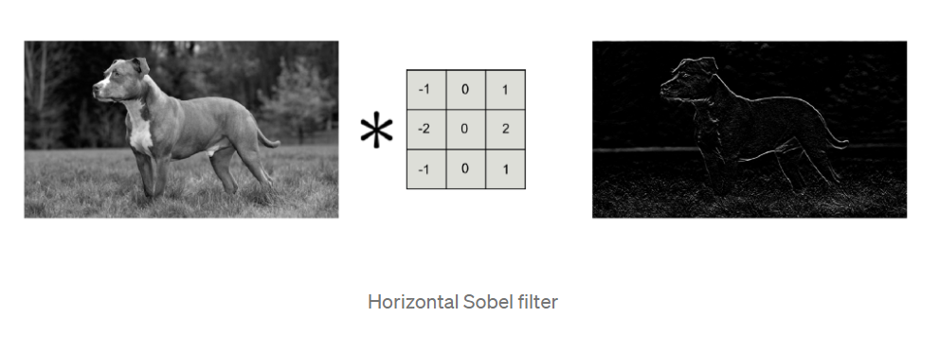
Each filter extracts a feature

Slide 10
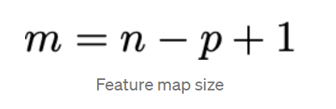
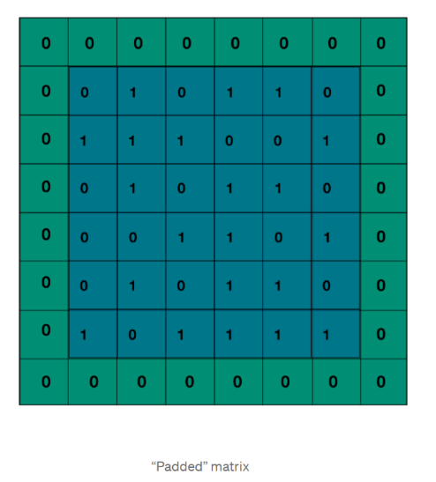
Applying filter ➔feature map
n the dimension of the input image
p the size of the filter. For example, for an initial 120x120px image and with a 5x5 kernel, the featured is sized 116x116px,
What If we want to output a feature map with the same size as the input image
Padding ➔ add zeros around the input image before the convolution, the input image is “padded with zeros”
6x6px with a 3x3 convolution filter. In the equation given above we then have p = 3, m = 6 so it comes that n = 6 + 3–1 = 8. Thus, it is necessary to have an input image sized 8x8px, which means we must add zeros all around the original matrix image to reach a size of 8x8px

Slide 11
Activation function RELU
During training, the coefficients of filters are updated ➔ the coefficients of the feature map , some might be negative
➔RELU replace the negative values with zeros

Slide 12
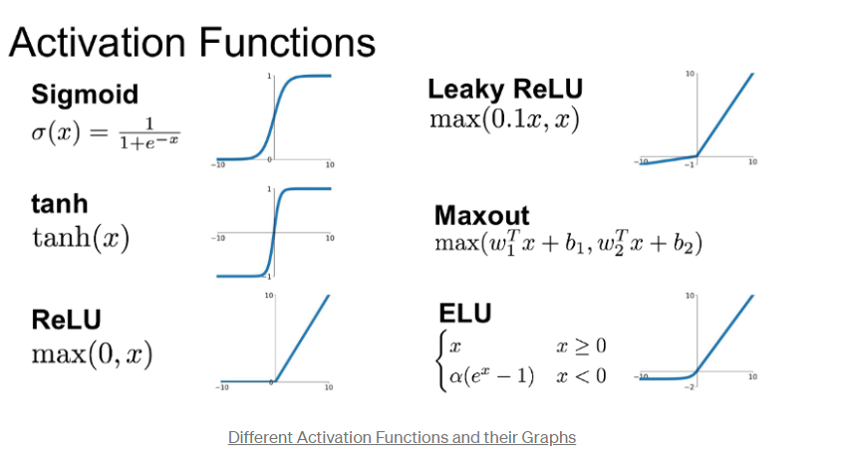

Slide 13
What is a convolution layer?
Convolution is to apply a filter or kernel to an input image, we then get a feature map that highlights characteristics or “features” of the input image:
To solve our classification problem
use several filters (as shape of ears, eyes and contours)
combining the features
Convolution Layer is:
How many filters to use? 64, 128, 256 … Which activation function? relu, sigmoid, tanh … With or without padding?
128 filers ➔a feature map per filter so 128
As a RGB image contains three channels (red, green and blue), a convolutional layer with 128 filters provides a single feature map but with 128 channels.

Slide 14
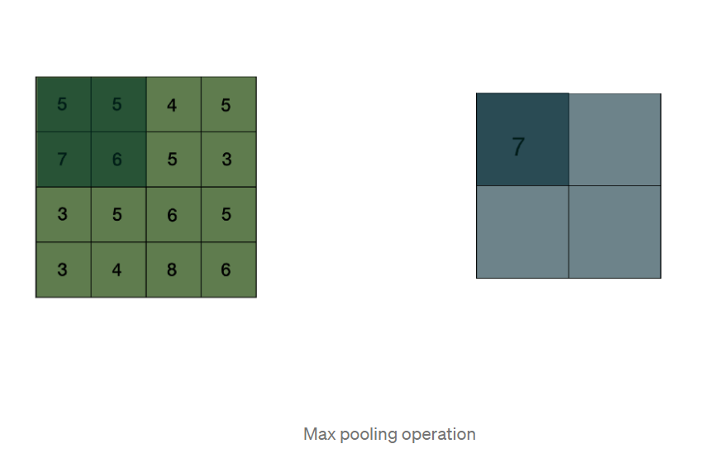
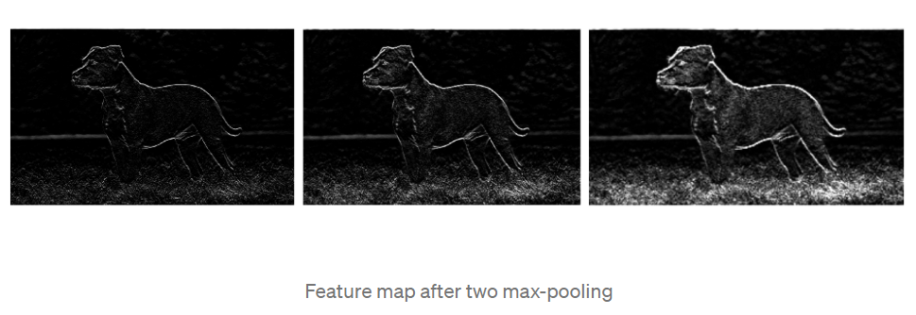
Max Pooling Algorithm
Pooling is not just about resizing but also keeping only the meaningful features of the input image.

Slide 15
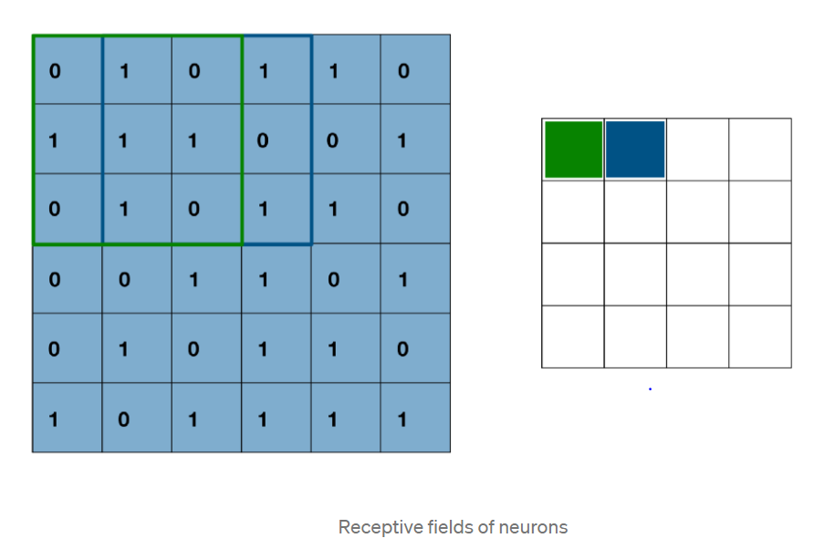
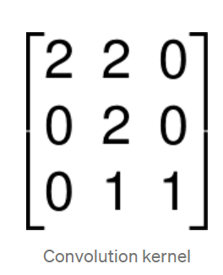
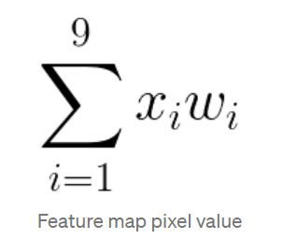
Neurons from feature map
Each pixel of the feature map is linked to one neuron, we then use m ** 2 neurons and each of them observes a field of size pxp with p ** 2 weights (one per filter coefficient) and one bias. ➔There are p ** 2 + 1 parameters for the m ** 2 neurons.
For example, with an input image sized 420x420px grayscale and a kernel sized 5 * 5 we will have a feature map with size m = 420–5 + 1 = 416 therefore 416 * 416 = 173056 neurons for one convolution!
With only 26(5*5 + 1) parameters to learn.
Image of size nxn with a pxp filter, outputs a feature map of size mxm(m=n-p+1)

Slide 16
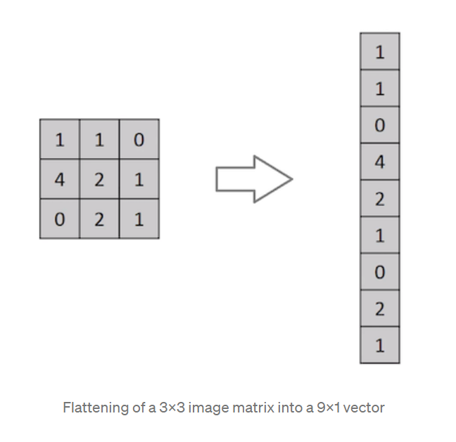
Flatten the feature map
To classify the image into a category(cat or dog)➔ set up a multilayer perceptron (Multi-Layer Perceptron) on top of the last convolution layer.
Since feeding a MLP requires input vectors (one-dimension arrays or 1d arrays), we need to “flatten” the output feature map.
The MLP therefore receives small-sized feature map as 1d array and chooses the corresponding category about those feature maps.

Slide 17
Smaller screen and smaller keyboard
Assume keyboard has only 2 keys / \
Screen is only 2x2 pixels
How will the computer recognize the letter from the image on the screen ?
Screen 1 Screen 2
Human Interpretation

Slide 18
Computer Interpretation
Flattening
what operation help to classify them as / or \
CLASSIFIER???

Slide 19
Classifier?
Add them ? 1-1-1+1=0
-1+1+1-1=0
No…
Multiply them?
1*-1*-1*1=1
-1*1*1*-1=1
No..

Slide 20
Excellent Classifier (operation)

Slide 21
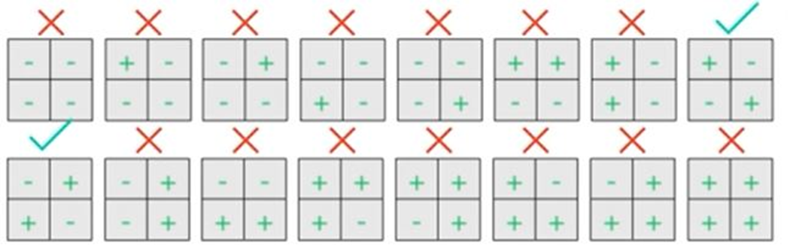
Classifier can identify wrong image
yes

Slide 22
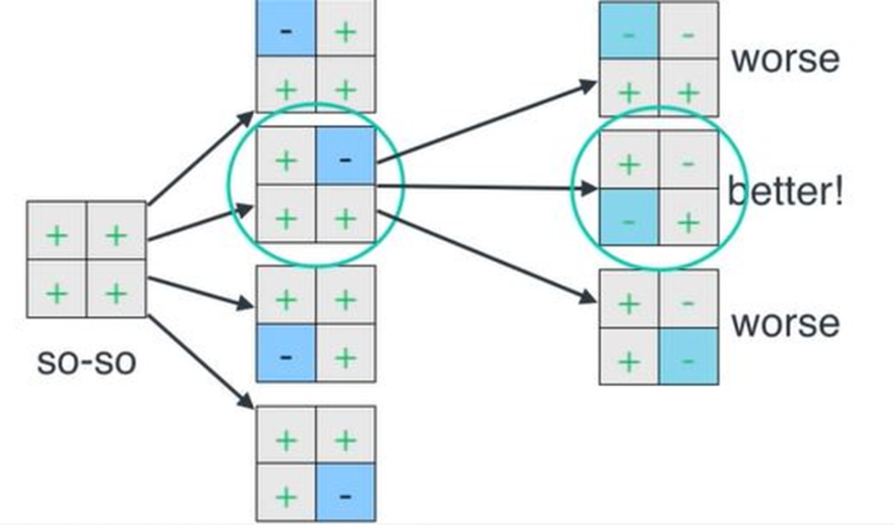
Selection of filter

Slide 23
Assume keyboard has only 4 keys / \ x o Screen is only 3x3 pixels How will the computer recognize the letter from the image on the screen ?
/ \ x o

Slide 25
What classier ?
Difficult so we break them into pieces (convolution) based on / and \ (as filter) we connect them again

Slide 26
Pooling(identifying)

Slide 27
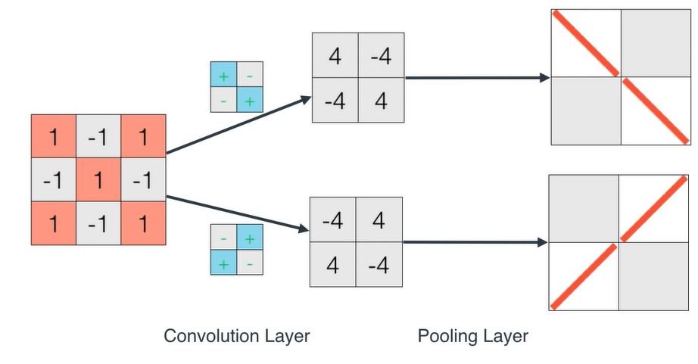
Convolution +Pooling
-4 is gray because based on the filter
We want to identify \
Is it a backslash? 4 yes -4 no

Slide 28
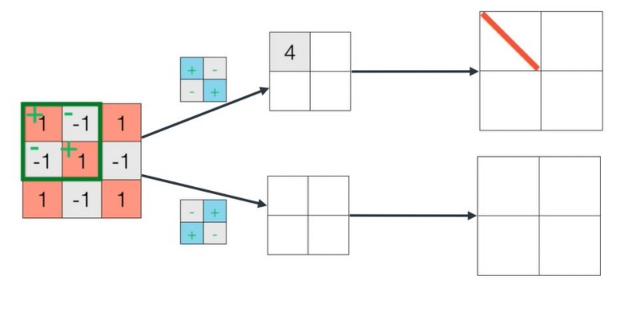
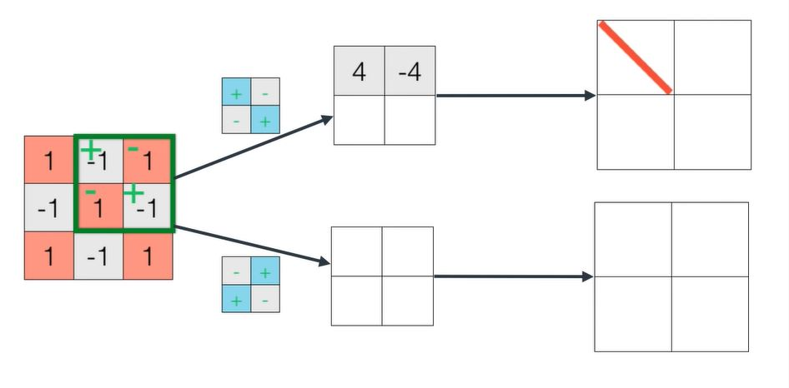
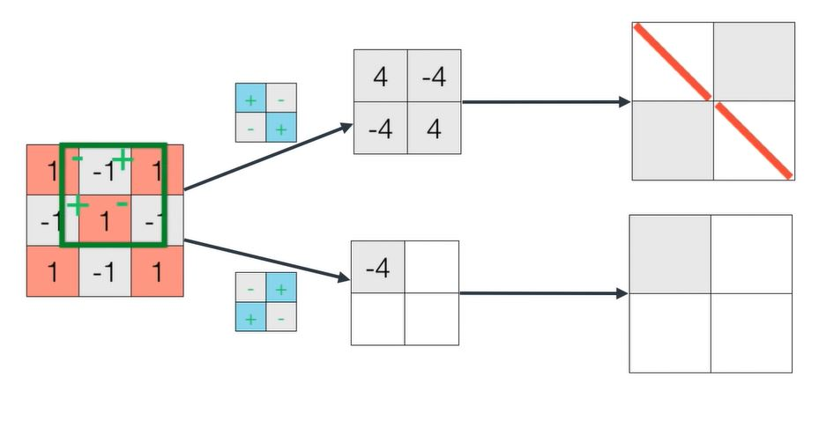
Two filters =kernels (each filter extract different features)

Slide 29
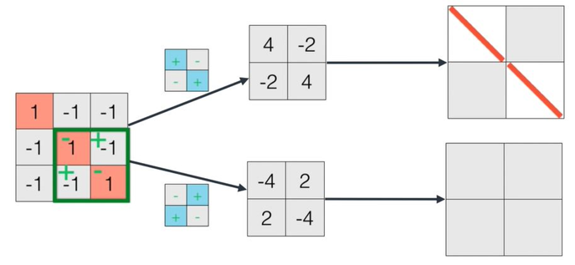
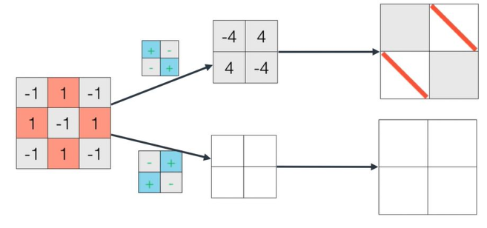
This filter is useless

Slide 30
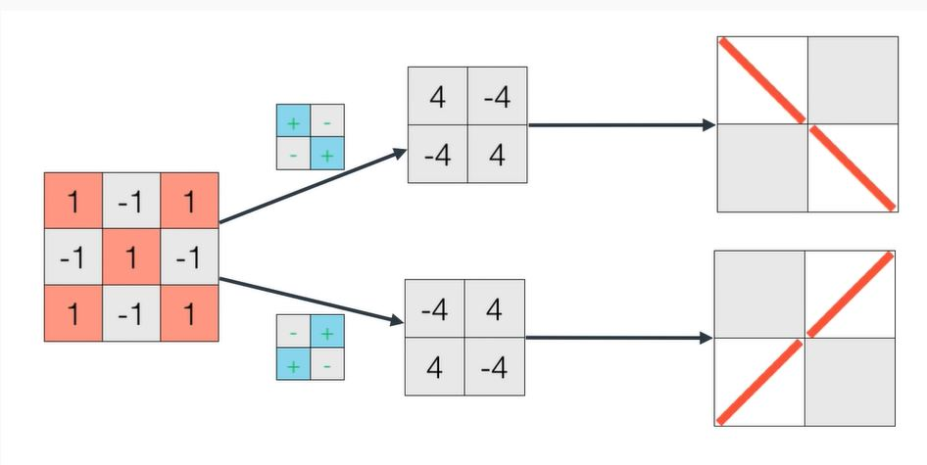
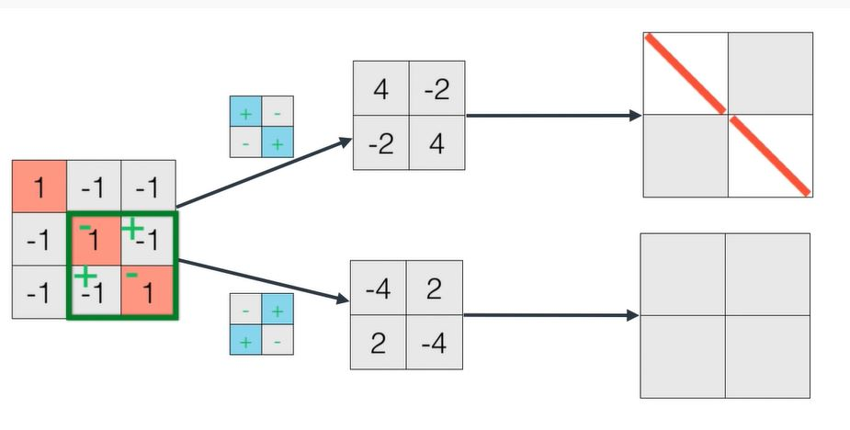

Slide 31
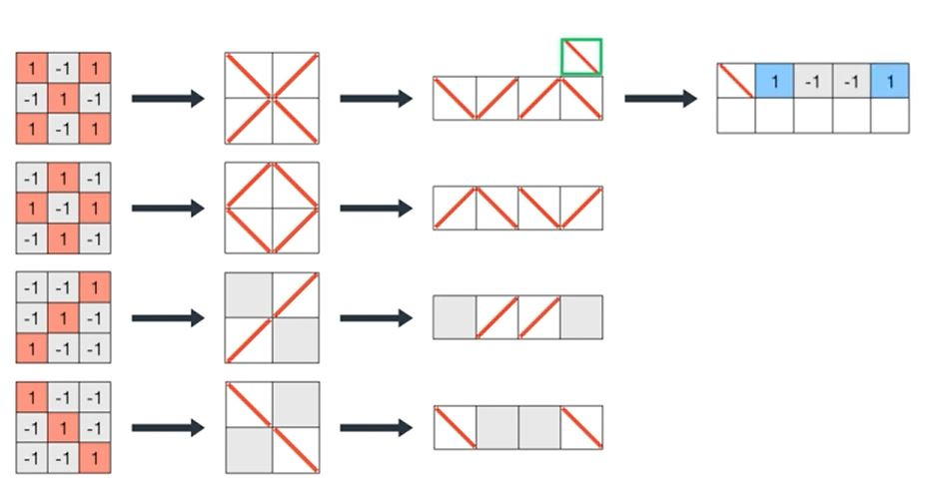
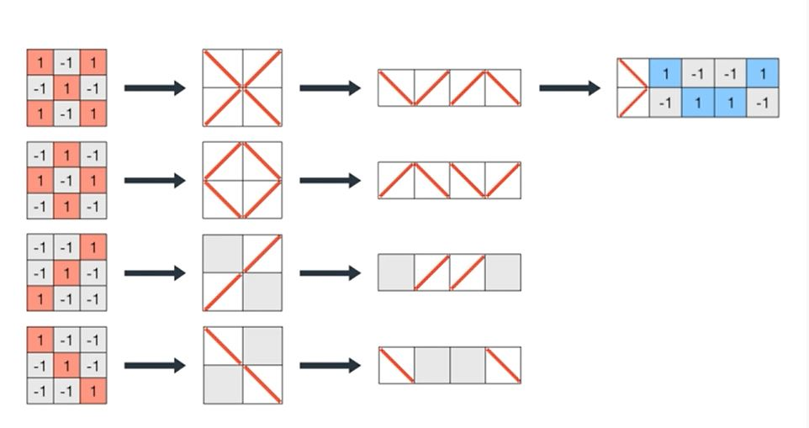
Identifying each pattern(feature)

Slide 32
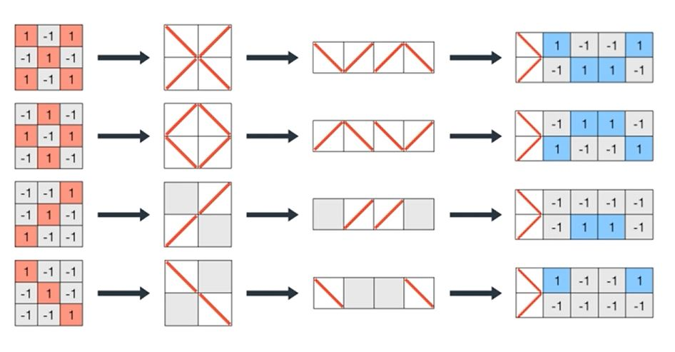
Encoding matrices (pooling=identifying)

Slide 33
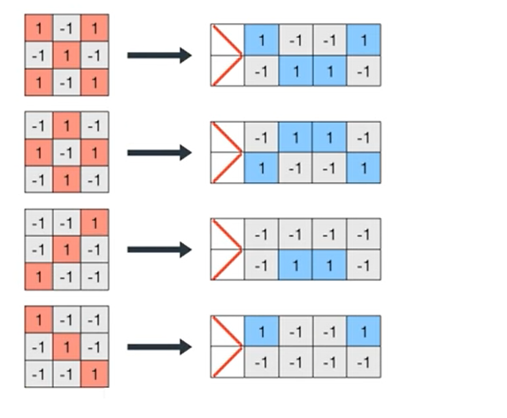
End of pooling=>converted the image
Into patterns(features) as a matrix of their location

Slide 34
Find the best filter to identify each letter x o / \
Recall for 2x2 we tried 16 possibilities and we find 2 good filters to identify \ and /

Slide 35
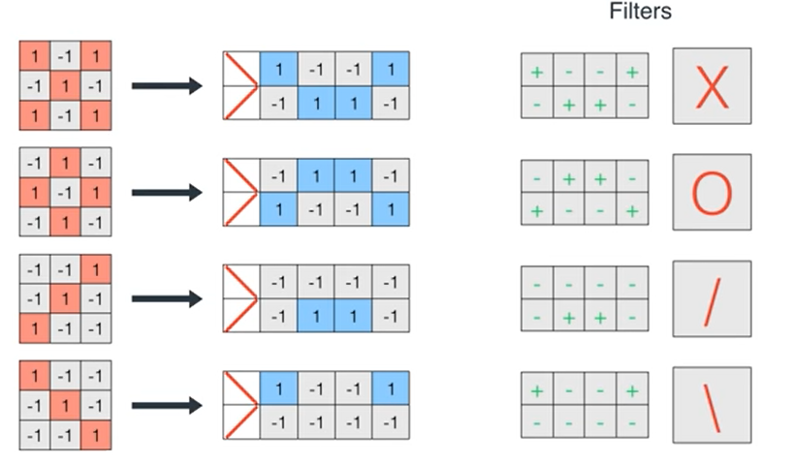

Slide 36
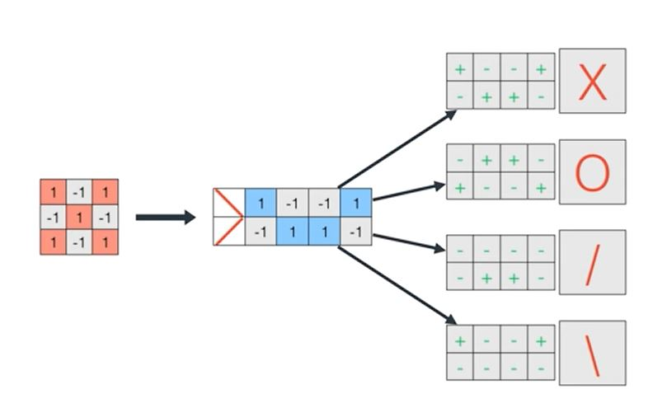
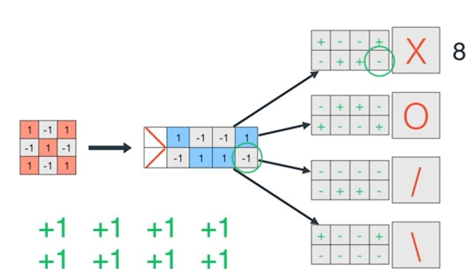
Reconnecting ………(NN classifier)
Compare matrix with every filter

Slide 37
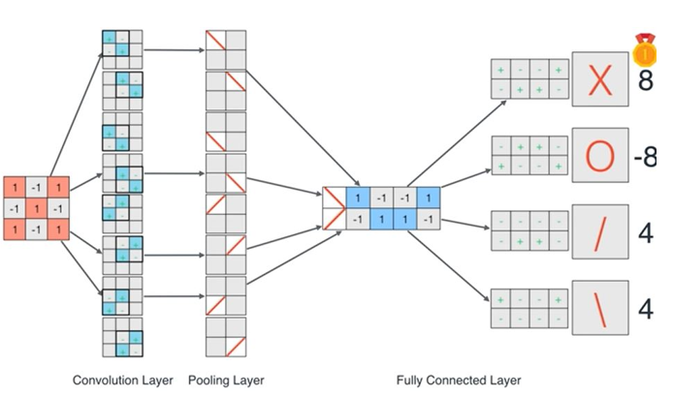
Input X …feature extraction ..find highest value
Computer identifies the left image as an X (highest value 8)

Slide 38
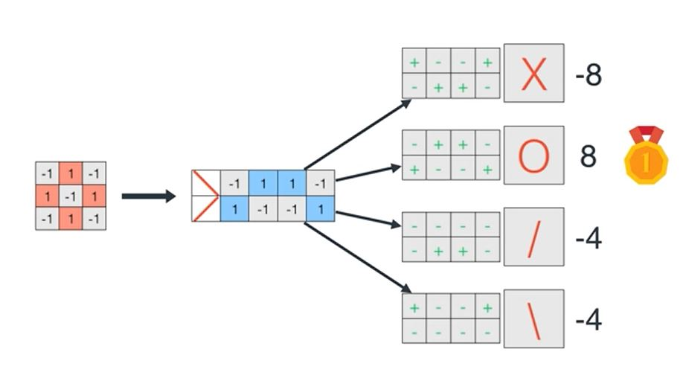
Computer identifies the left image as an O (highest value 8)

Slide 39
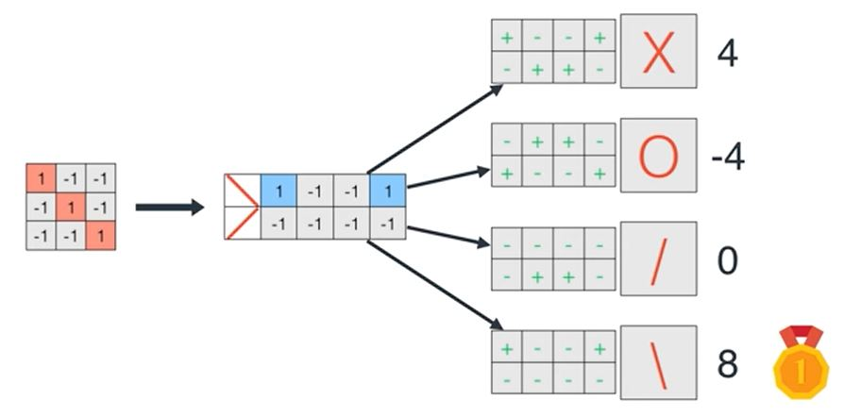
Computer identifies the left image as an \ (highest value 8)

Slide 40
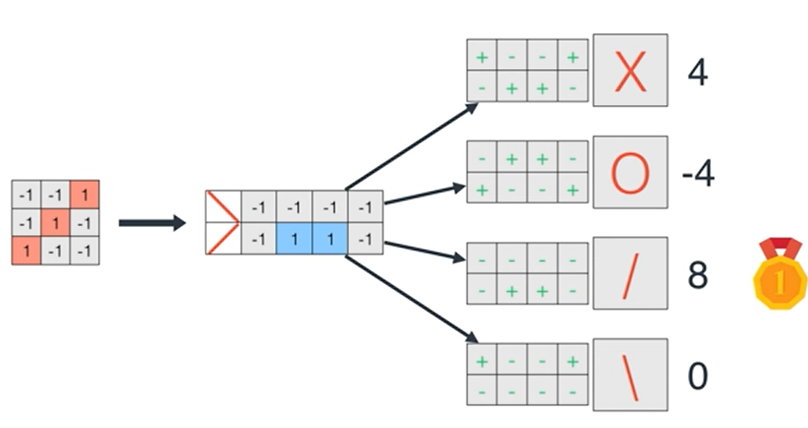
Computer identifies the left image as / (highest value 8)

Slide 41
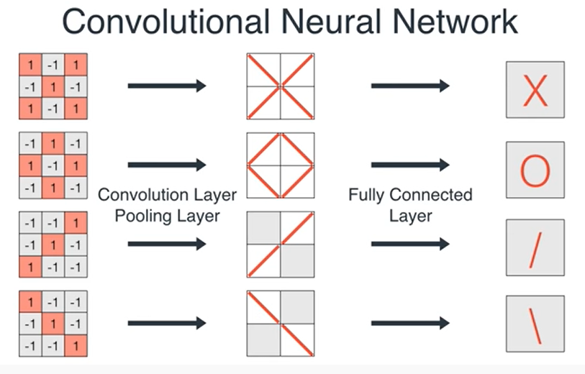

Slide 42
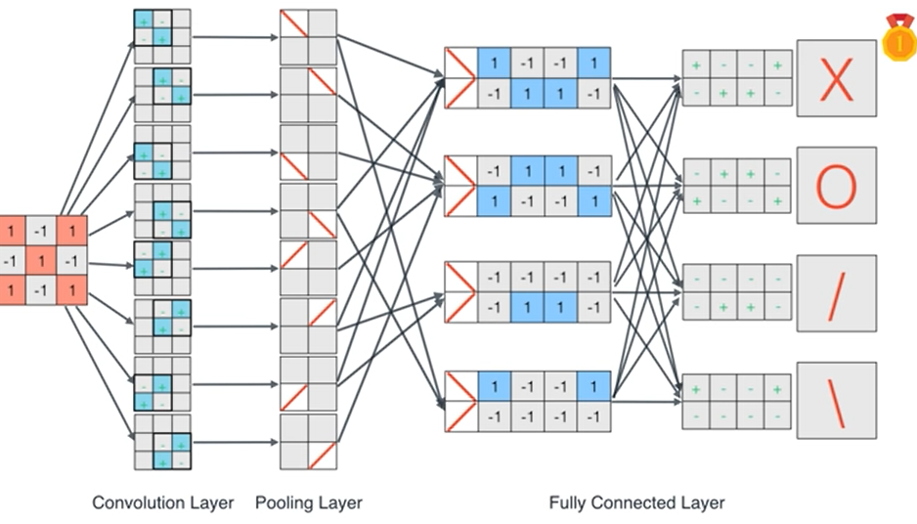
Summary (8 filters )

Slide 43
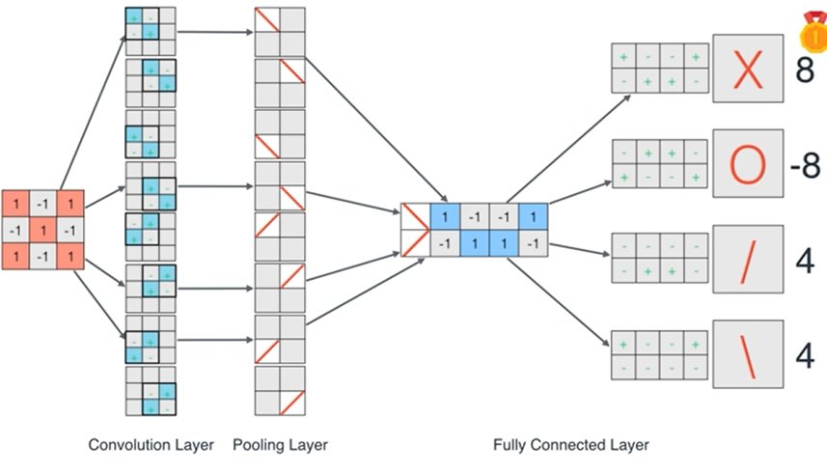
X IS

Slide 44
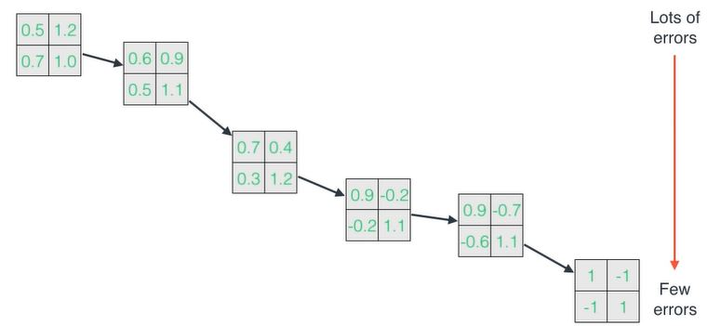
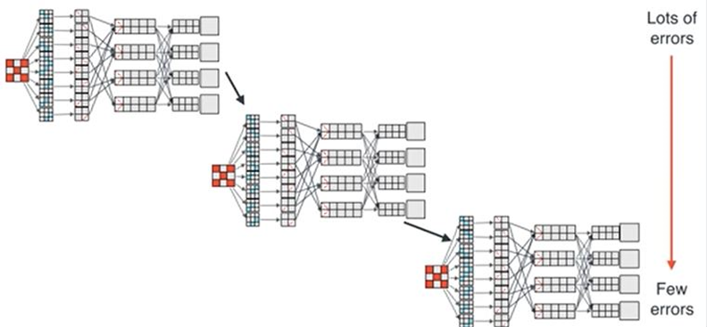
Gradient descent is used to find best filter

